Slide 1


Slide 2
Trainer Guidelines for Conducting Class
Solve questions live by creating new blank files (Excel, Python, Jupyter notebook, Dashboard) during the session, rather than sharing completed solutions.
Review teaching materials and solutions beforehand, and prepare additional examples to reinforce learning.
Ensure online students can hear you and see the screen clearly at all times.
Test your computer and necessary software before class begins.
Check with online students every 15-20 minutes to see if they understand the material and have any questions.

Slide 3

Agenda: Data Science Workflow - 2
Introduction
Dataset Overview
NLP Model Development
Deep Learning Model Development
Model Evaluation
Model Deployment With Streamlit
Q&A and Discussion

Slide 4
Overview of Today's Session
Focus on NLP and Deep Learning
"Twitter Sentiment Analysis" dataset
Session Roadmap:
NLP Model Development
Deep Learning Model Development
Model Evaluation
Model Deployment with Streamlit
Industry Relevance

Slide 5
Deep Learning & NLP
Deep Learning:
Subfield of machine learning.
Neural networks with multiple layers.
Used in image recognition, speech recognition, and NLP.
Models: DNN, CNN, RNN.
Natural Language Processing (NLP):
AI field for human-computer language interaction.
Tasks: text classification, language translation, sentiment analysis.
Models: RNNs, Transformers.
Applications:
Text classification, language translation, NER.
Question answering, text generation, speech recognition.

Slide 6
Deep Learning & NLP
Aspect | Deep Learning | NLP (Natural Language Processing)
Focus | Data modeling for complex tasks | Language understanding and tasks
Data Type | Numeric data (e.g., images) | Text and sequential data
Main Applications | Image recognition, speech recognition, autonomous vehicles | Text classification, language translation, chatbots, sentiment analysis
Common Models | Neural networks (CNN, RNN, LSTM), Transformers | RNNs, Transformers, BERT, spaCy
Frameworks | TensorFlow, PyTorch, Keras | NLTK, spaCy, GPT-3, BERT, Transformers
Use Cases | Object detection, gaming AI, natural language understanding | Chatbots, voice assistants, text summarization

Slide 7
Dataset Overview
Twitter Sentiment Analysis Dataset
The dataset used is for Twitter Sentiment Analysis.
Industry Applications: Real-World Relevance
Sentiment analysis has real-world applications, such as brand reputation management, customer feedback analysis, and stock market prediction.
Key Columns and Features: Important Dataset Components
Notable columns include "clean_text" and "category," where "clean_text" represents the tweets and "category" the sentiment label.

Slide 8
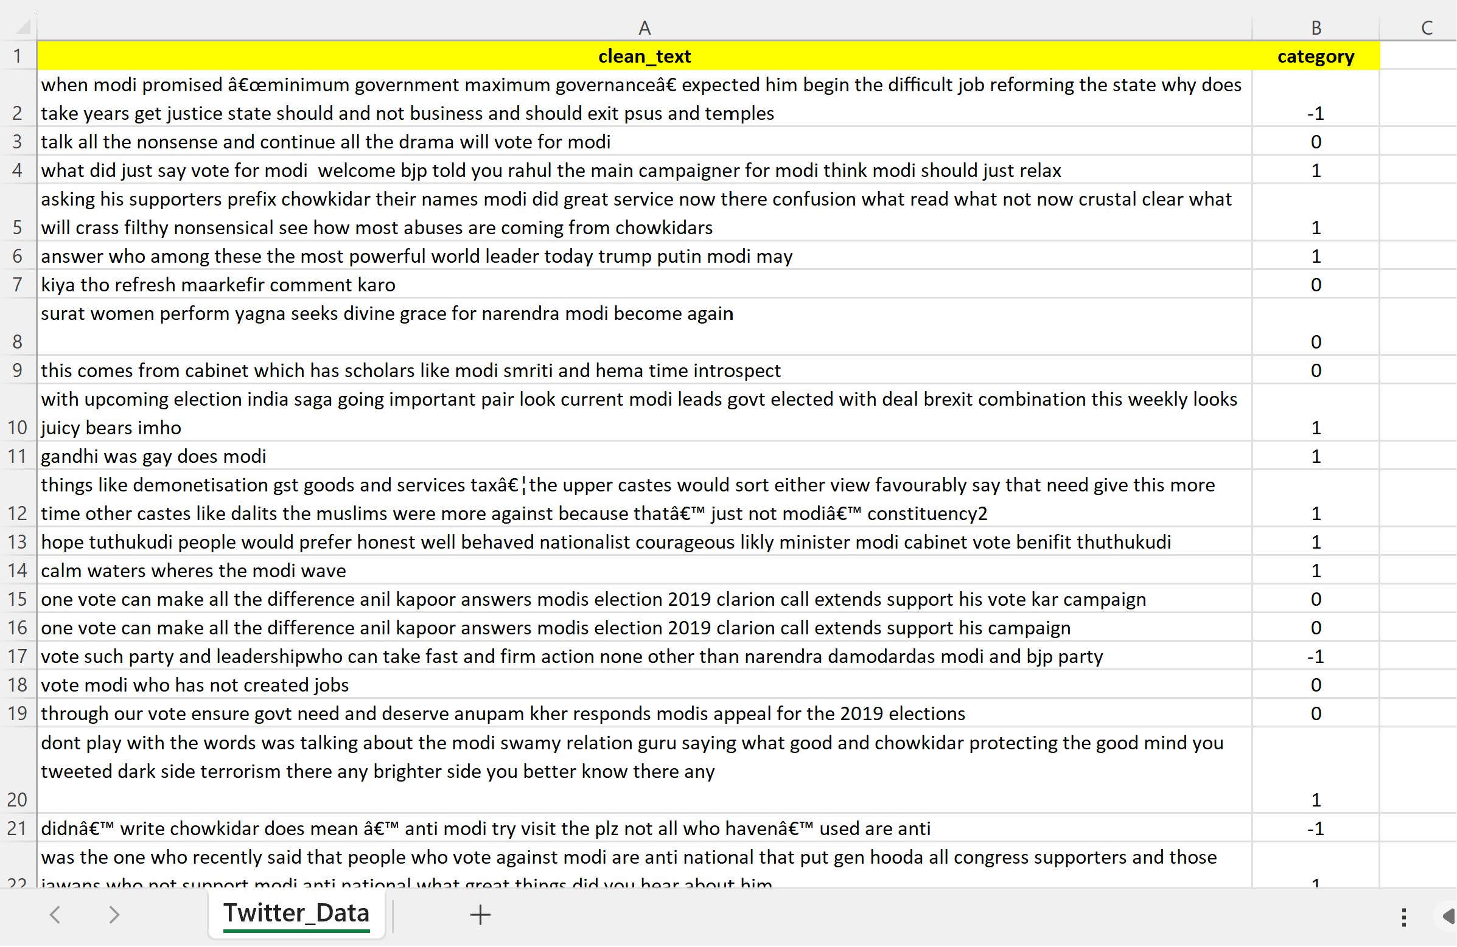
Dataset Overview

Slide 9
NLP Model Development
Introduction to NLP: Unlocking Language Understanding
Natural Language Processing (NLP) is a field of AI that focuses on the interaction between computers and human language.
Text Data Preprocessing: Preparing Text for Analysis
Steps such as tokenization and data cleaning are essential for transforming raw text into structured data.
Select NLP Model: Building Sentiment Analysis
We will dive into NLP model selection, specifically Sentiment Analysis, utilizing libraries like NLTK.

Slide 10
Deep Learning Model Development
Introduction to Deep Learning
Deep Learning is a subset of Machine Learning that focuses on neural networks with multiple layers.
It is especially powerful for tasks involving unstructured data, such as text.
Choose Deep Learning Framework (TensorFlow)
TensorFlow is a popular open-source deep learning framework developed by Google.
It provides tools for building and training neural networks efficiently.

Slide 11
Deep Learning Model Development
Building a Neural Network for Sentiment Analysis
Define the architecture of the neural network.
Input layer, hidden layers, and output layer.
Use embeddings and recurrent layers for processing text data.
Output layer with appropriate activation for sentiment analysis (e.g., sigmoid).
Training the model using backpropagation and optimization techniques.
Evaluate the model's performance on the sentiment analysis task.

Slide 12
Model Evaluation
Metrics for NLP and Deep Learning Models
Metrics include accuracy, precision, recall, F1-score, and ROC AUC.
Evaluating Model Performance
Assess performance with accuracy, precision, recall, and F1-score.
Visualize ROC curves for binary classification models.
Model Strengths and Limitations
Highlight model strengths and potential biases.
Discuss real-world applications and generalization challenges.

Slide 13
Model Deployment with Streamlit
Introduction to Streamlit
A Python library for web app development.
Fast and efficient for creating interactive applications.
Hands-On: Building a Sentiment Analysis App
Creating a web app for sentiment analysis.
Real-time user text input and analysis.
Local Deployment
Running the app on your local machine.
Easy access via a web browser.
Real-World Deployment
Exploring hosting and deployment options.
Considerations for choosing the right hosting solution.

Slide 14
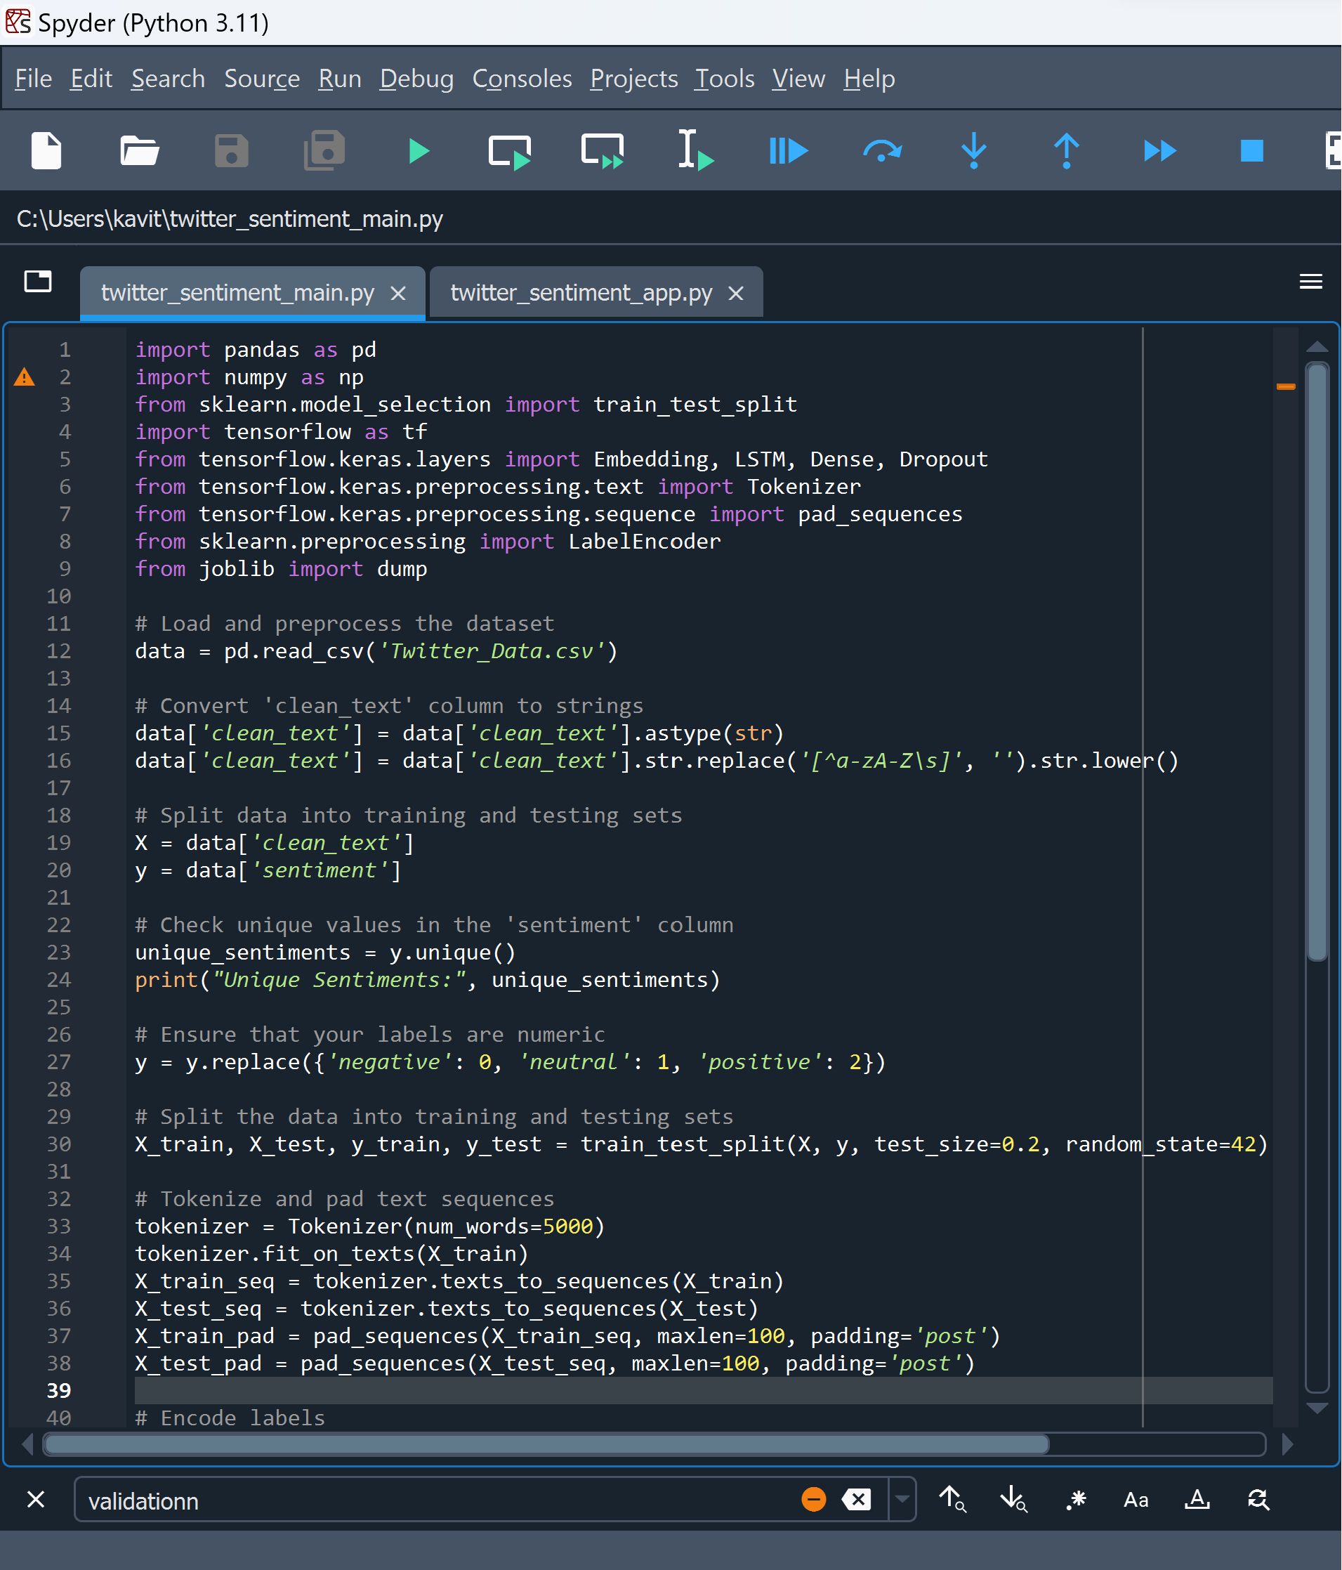
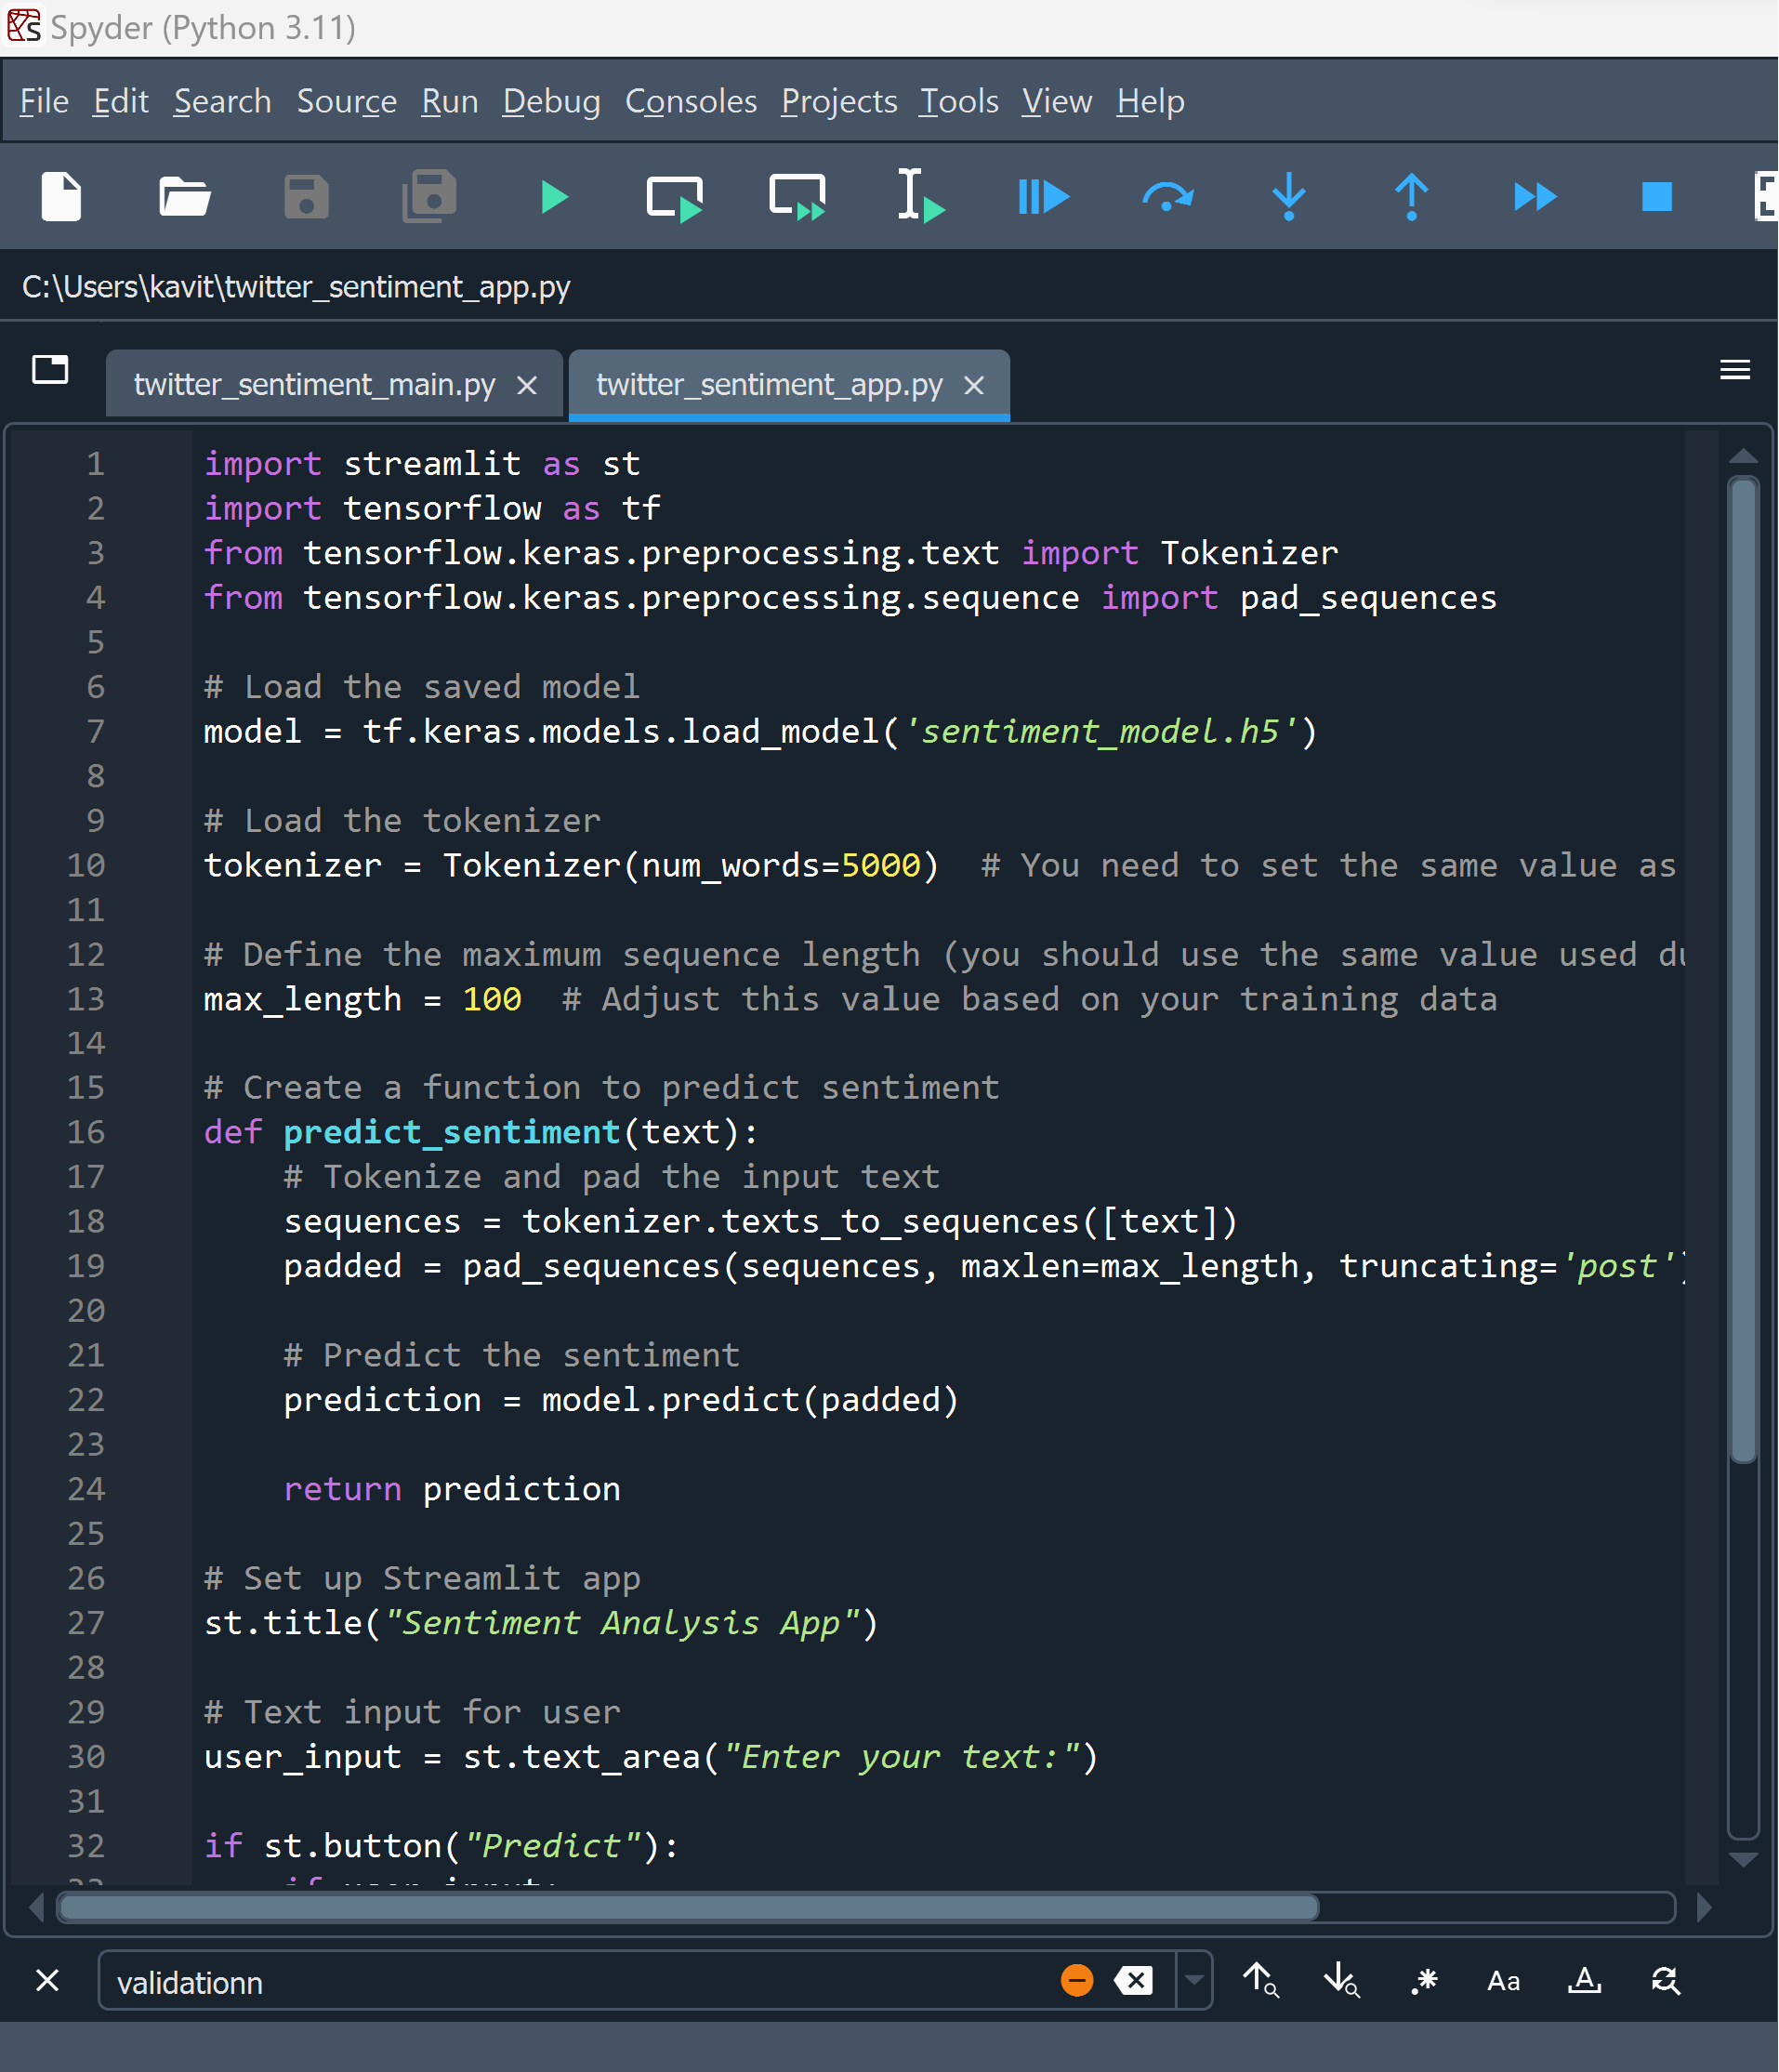
Model Deployment
Twitter Sentiment ML Model file – twitter_sentiment_main.py
Streamlit Web App file – twitter_sentiment_app.py
Notes:
Note: - Use Python file for these codes

Slide 15
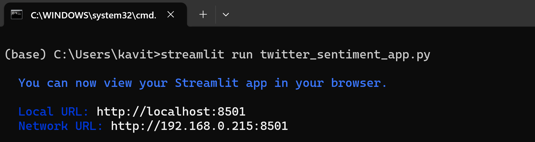
Model Deployment
Running twitter_sentiment_app.py File in same environment where Twitter_Data.csv (dataset), twitter_sentiment_main.py and Spyder is present
Streamlit run twitter_sentiment_app.py

Slide 16
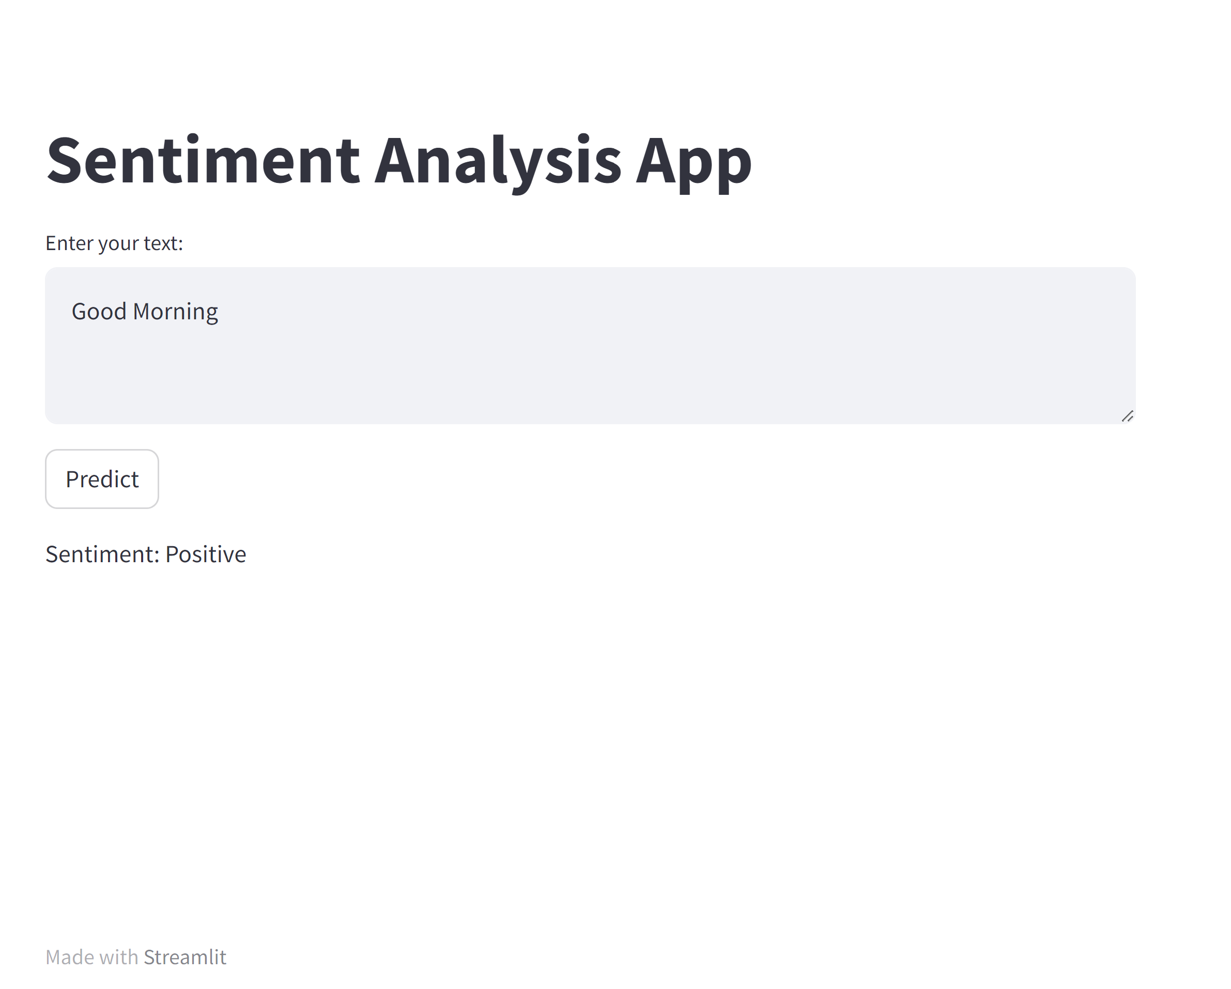
Model Deployment
Streamlit web app for Sentiment Analysis App
App Name
2. User Input
3. Output

Slide 17
Questions ?

Slide 18
Thank You !

